Slide 1

Financial Aid
What is it?
How to apply?
Questions?

Slide 2
Financial Aid
Three kinds of funding through FAFSA
  Grants: don’t pay back
  Loans: borrowed money, must pay back
  Work Study: campus job that pays you
Other forms of aid $$$
Scholarships
Veterans’ Education Benefits
Work First Tuition Assistance
Worker Retraining
BFET

Slide 3

FAFSA
Free Application for Federal Student Aid
One application filled out once an academic year
(opens every year in January)
Determines your eligibility for grants, loans, and/or work study
Requires you to answer questions using previous year’s income tax return information. You need parent’s information too if you are under 24 years old.

Slide 4
The Big Picture
An academic year:
Summer, Fall, Winter, Spring
2014-2015 (use 2013 income information)
*Winter 15, Spring 15
*2015-2016 application opens in January 2015

Slide 5
SPSCC Financial Aid
Application Deadlines
If you are applying for Winter Quarter, 2015
the deadline for your file to be completed is October 23, 2014.
If you are applying for Spring Quarter, 2015 the deadline for your file to be completed is Jan. 29, 2015.

Slide 6
Financial Aid Workshops
One-on-one assistance
Bring 2013 tax returns or year end income information (for 2014-15 FAFSA). Need parent’s income information if you are under 24 years old.
Building 22 room 211. No need to sign up, just show up!
October 16 from 9 a.m. - 10 a.m.
October 28 from 2 p.m. - 3 p.m.

Slide 7
General Student Eligibility Criteria
A student must
fill out a college admissions form
be enrolled in an eligible program of study (check with financial aid in building 22 if you are unsure)
be a U.S. citizen or eligible noncitizen (green card, permanent resident card, etc.)
have valid Social Security Number (SSN)
have a HS diploma or GED.
not be in default on a loan or owe a repayment of grant funds.
make satisfactory academic progress
-- need to maintain a 2.0 (C average)

Slide 8
Dream Act Student Eligibility Criteria
Dream Act Students
Are not a US citizen (no SSN) and do not have immigration documentation
Do have a GED or high school diploma from WA state
Have lived in WA 3 years before getting GED or high school diploma
And have continued to live in WA since getting a GED or high school diploma.
DO NOT FILL OUT FAFSA
Fill out WASFA (WA Application for State Financial Aid)
www.ReadySetGrad.org/WASFA

Slide 9
Student Enrollment
Full time = 12+ credits (100%)
¾ time = 9-11 credits (75%)
½ time = 6-8 credits (50%)
Less than half time = 1-5 credits (25% or less)

Slide 10
Application Process
Complete an SPSCC admissions form (paper or online)
Complete and submit FAFSA (or WASFA) before priority deadline.
Complete and submit SPSCC Data Sheet before priority deadline.
Submit requested verification materials – such as, GED test record, copy of Social Security card,
tax transcripts, etc.
Most aid is on “first-come, first-served”
basis.

Slide 11
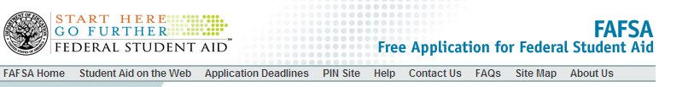
FAFSA on the Web
Web site: https://fafsa.ed.gov/
FAFSA on the Web Worksheet: Use Search box to find.
  Used as worksheet for on-line entry
  Questions follow order of FAFSA on the Web

Slide 12
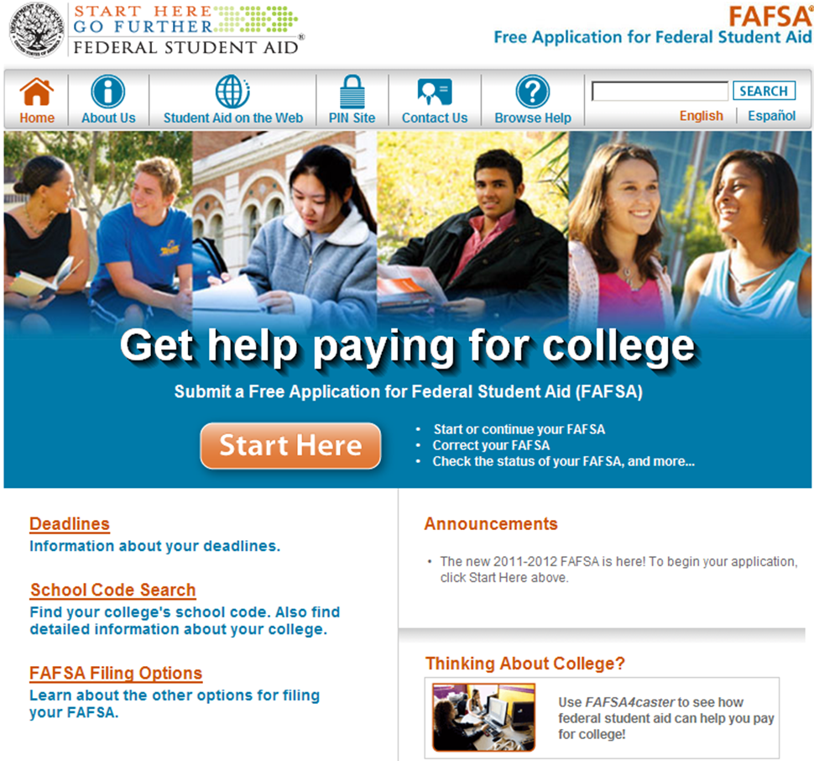
FAFSA on the Web Homepage

Slide 13
FAFSA APPLICATION STEPS
Gather previous year’s income tax return or end of year income information.
If you are under the age of 24, you also need your parent(s) income information.
Fill out FAFSA worksheet.
Apply for a PIN: This how you
“sign” your FAFSA application.
You will also create a password.
Keep track of this information!

Slide 14
FAFSA on the Web Homepage
Click on “Pin Site” to apply for a pin.
Make sure you remember your pin. If you use a parent’s information, he or she will need to apply for a pin too.

Slide 15
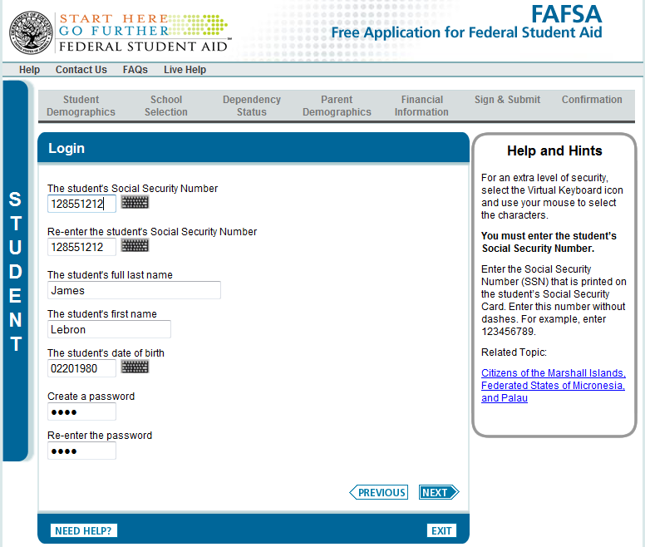

Slide 16

Opportunity Grant:
Money for low-income students
For Washington residents
First step is to fill out a current FAFSA or WASFA
For academic pathways that include:
Accounting
Automotive
Early Childhood Education
Certified Nursing Assistant
Medical Assisting
Office Administration
Welding

Slide 17
Scholarship Search Options
College Foundation Scholarship
  Applications available in March- due mid-April
  One application to be considered for all scholarships
    One page letter from you explaining why you should get money
    2 Letters of Recommendation from other people explaining why you should get money
  Visit the Writing Center for writing assistance.
SPSCC Scholarship Information on the web
http://www.spscc.ctc.edu/admissions/funding/scholarships
The Washington Scholarship Coalition
www.TheWashBoard.org

Slide 18
Other Sources of $$$$
Work First Tuition Assistance (must qualify for TANF-- Temporary Aid to Needy Families) through DSHS.
BFET (Basic Food Employment & Training Program) for students who
  qualify for DSHS Basic Food Assistance,
  who are not on TANF,
  and who are enrolled in 6 or more credits in an eligible program.
Contact: Tonya Huffines thuffines@spscc.edu 360-596-5401, Bldg. 22-222
Visit http://www.spscc.ctc.edu/programs
Or ask for more information in the student “one stop shop” upstairs in building 22

Slide 19
Other Sources of $$$$
Veterans' Education Benefits
http://www.spscc.ctc.edu/admissions/funding/veterans
Contact: Mary Davis mdavis@spscc.edu (360) 596-5242 , Bldg. 22-236
Worker Retraining (must be unemployed and be receiving unemployment benefits or have run out of benefits within the last 24 months.)
Contact: Christina Winstead cwinstead@spscc.edu
(360) 596-5446, Bldg. 22-220
Visit http://www.spscc.ctc.edu/programs
Or ask for more information in the student “one stop shop” upstairs in building 22

Slide 20
Questions?
Visit Student “one stop shop” upstairs in building 22
Or make an appointment with me! I can help walk you through the process.
Angela Holley (Building 34, room 108)
aholley@spscc.edu
360-754-7711 ext. 3366

