Slide 1
ABE/GED Student Orientation
How to Fill Out Required Forms

Slide 2
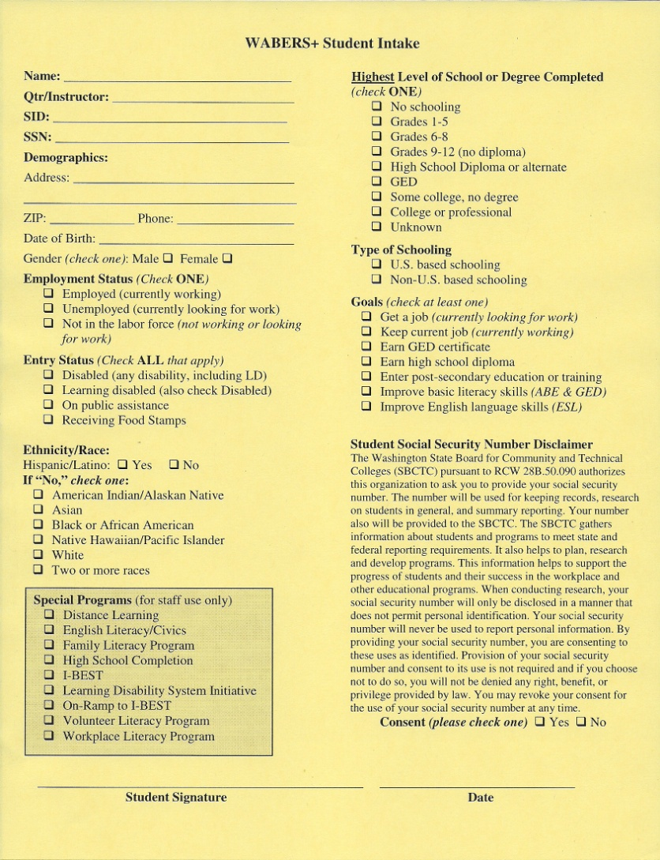
WABERS+ Student Intake
This form must be filled out in BLUE ink.
Let’s go through the different parts of the form together.

Slide 3
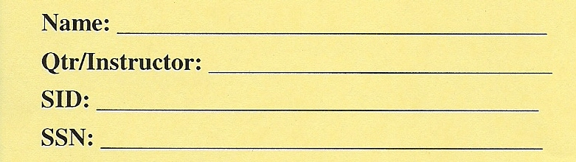
WABERS+ Student Intake
Fill out ALL of these areas.
Please PRINT your LAST name, then your FIRST name.
Qrtr/Instructor: Quarter (F, W, SP, or SU) and Year (2012) + your teacher’s name. Example: SP2012/Fitz
SID = Student ID number
SSN = Social Security Number
Notes:
Print clearly
*LAST name, FIRST name
Include SID only
Don’t have students include SSN – can not guarantee security
Ethnicity – If more than one, select one category. “Other” is an option

Slide 4
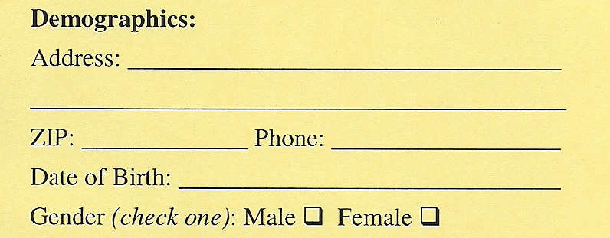
WABERS+ Student Intake
Address and ZIP are where you actually live. It is important to write your ZIP.
Phone is whichever number where you can be reached
Date of Birth is Month, Day, Year
Notes:
ZIP codes are used for demographic comparison of general population in living area, geographic disbursement of students, and identifying legislative districting of students.

Slide 5
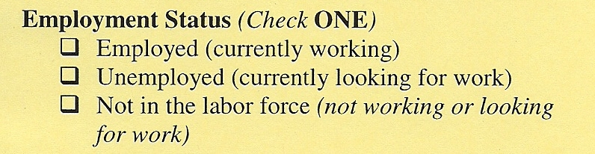
WABERS+ Student Intake
“Employed” means you are getting a pay check with taxes, not working for cash.
“Unemployed” means you are looking for work AND filling out job applications right now.
“Not in the labor force” means you are not looking for work and don’t have a job right now.

Slide 6
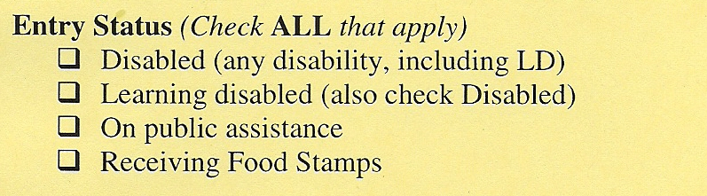
WABERS+ Student Intake
If you check “Learning disabled”, then also check “Disabled”
“On public assistance” means you get money from a government organization. (This includes TANF, food stamps, refugee cash assistance, old-age assistance, or aid to blind or totally disabled. It does NOT include social security benefits, unemployment insurance, and employment-funded disability.)
If you check “Receiving food stamps,” ALSO check “On public assistance.”

Slide 7
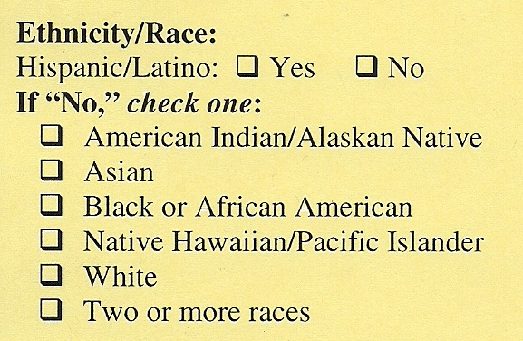
WABERS+ Student Intake
If you are Hispanic/Latino, check yes and STOP
If you are NOT Hispanic/Latino, pick ONE of the other choices.
If you are MORE than ONE, pick the LAST option.

Slide 8
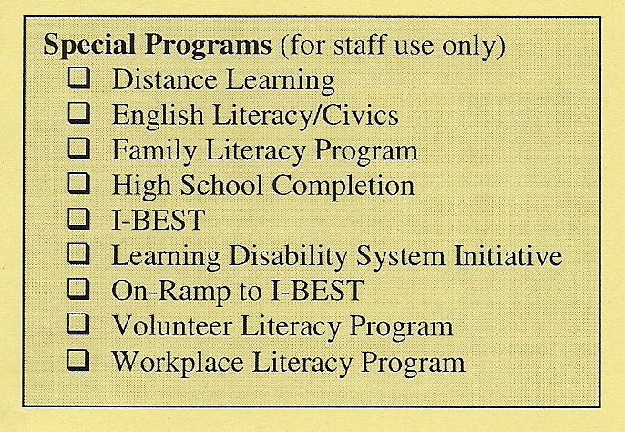
WABERS+ Student Intake
DO NOT check any of the boxes in this area.
Your teacher will talk to you directly if you need to check a box in this area.
Notes:
If student checks “Employed”, should also check “Keep current job”
If student checks “Unemployed”, should also check “Get a Job”
If student isn’t really looking for work, student should check “Not in the labor force”

Slide 9
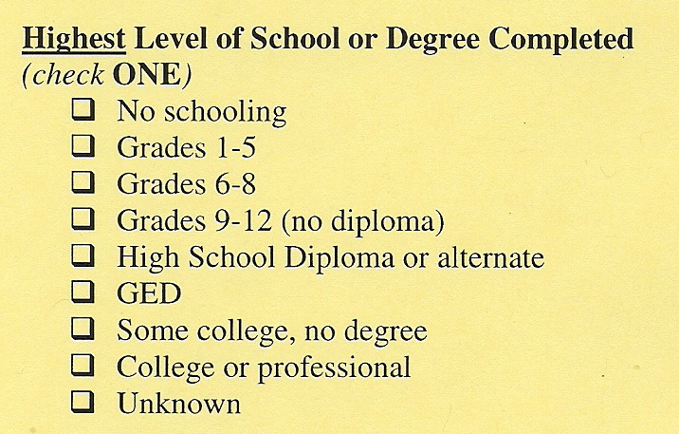
WABERS+ Student Intake
Check ONLY ONE box

Slide 10

WABERS+ Student Intake
Check ONLY ONE box
“U.S. based schooling” includes U.S. military schools all over the world.
“Non-U.S. based school” means anything else.

Slide 11
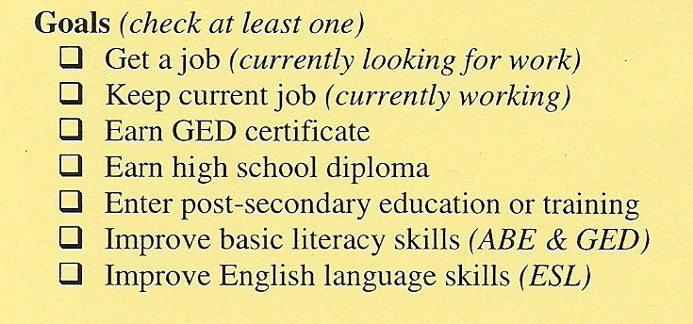
WABERS+ Student Intake
If you check “Employed” in the Employment Status area, then also check “Keep current job”
If you check “Unemployed” in the Employment Status area, then also check “Get a Job”

Slide 12
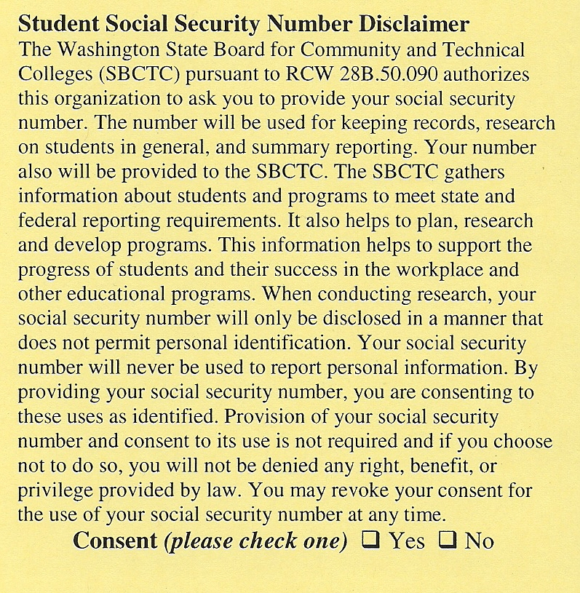
WABERS+ Student Intake
The school uses your Social Security Number to track your education and employment goals to see if you get what you said you wanted.
If you allow this tracking, check YES.
Notes:
If student isn’t really looking for work, student should check “Not in the labor force”

Slide 13
WABERS+ Student Intake
Sign this! Date it! In BLUE INK.
This shows that you filled out the information yourself.
Notes:
Sign this! Date it! In INK. It is a contractual document. We need this recordkeeping for federal funding.

Slide 14
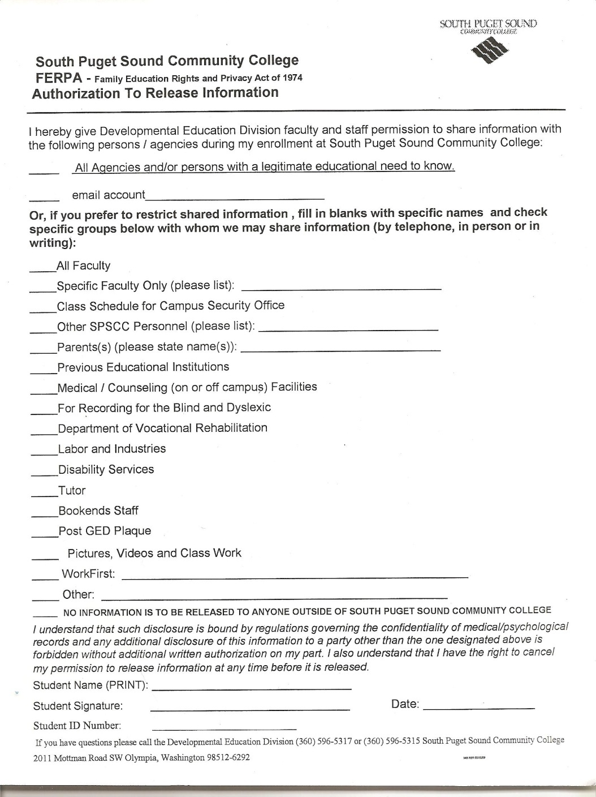
FERPA
Family Education Rights and Privacy Act of 1974
This form lets us know who we CAN and CANNOT talk to about your education.
It needs to be filled out in BLUE ink.
Notes:
Must turn this in to Melaina. She keeps the original.
Make copies for your student files, then turn the originals in to Melaina.

Slide 15
FERPA
Mark here if it is okay for your teacher to talk about your learning with non-school people who need to know.
Add your email address so we confirm that an email request is really from you.
Family Education Rights and Privacy Act of 1974
Notes:
Must turn this in to Melaina. She keeps the original.
Make copies for your student files, then turn the originals in to Melaina.

Slide 16
FERPA
Family Education Rights and Privacy Act of 1974
Mark any of these if there is a specific person we SHOULD or SHOULD NOT talk to about your learning. You have to write their names next to the area and tell us if we can or cannot talk to them.
Notes:
Must turn this in to Melaina. She keeps the original.
Make copies for your student files, then turn the originals in to Melaina.

Slide 17
FERPA
Family Education Rights and Privacy Act of 1974
Don’t forget:
Print your name
Sign your name in cursive
Write today’s date
Write your Student ID Number
Your teacher knows your Student ID Number if you don’t
Notes:
Must turn this in to Melaina. She keeps the original.
Make copies for your student files, then turn the originals in to Melaina.

Slide 18
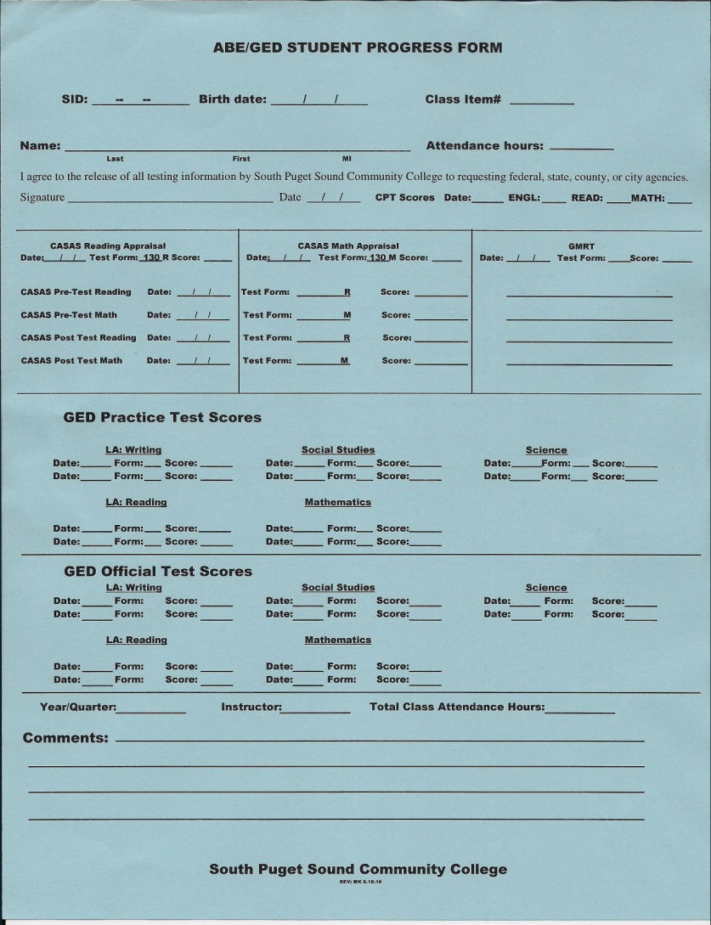
ABE/GED Student Progress Record
This form must be filled out in BLUE ink.
You fill out only a small amount of this form.
Let’s go through those parts together.

Slide 19
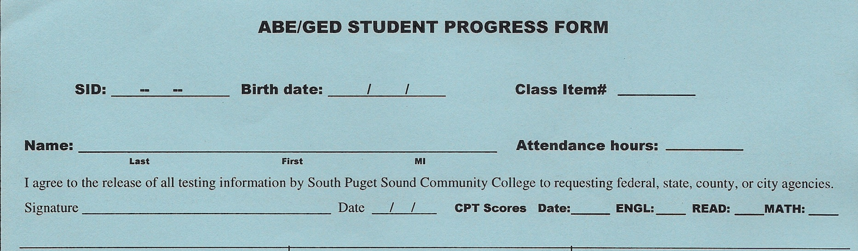
ABE/GED Student Progress Record
Fill out only the yellow boxed areas with BLUE ink.
Please Print your name – Last, First, Middle Initial.
Please sign your name in cursive.
Notes:
Students must sign and date in INK.

Slide 20
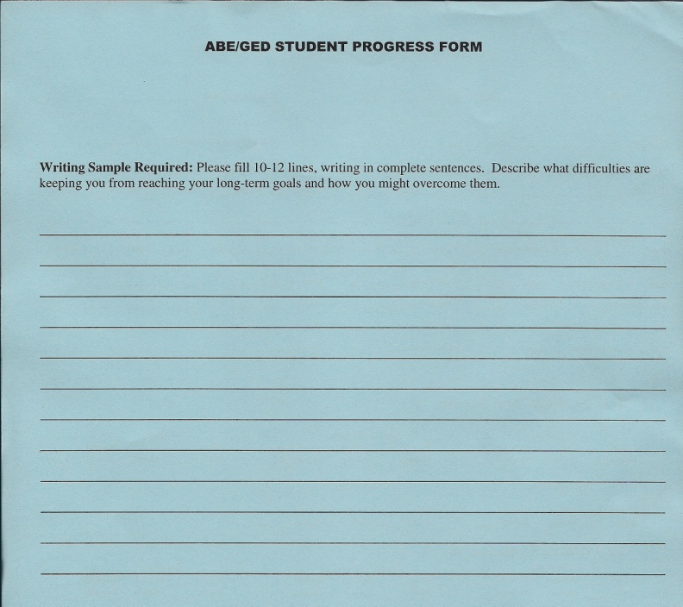
ABE/GED Student Progress Record
This is the back side of the form. This is a required writing sample. You should read the directions and write 10-12 lines.
It helps your teacher learn a little about you. It also lets the teacher see what your writing looks like.
Notes:
This is the first (pre) writing sample for the quarter.
Students are supposed to also complete a post writing sample at the end of the quarter.

Slide 21
ABE/GED Student Orientation
Congratulations!
You are all done with your forms.
Please give these forms to your teacher.

